Slide 1


Unit – 5.2 Group Theory
B.Tech. $→3$^{st} Semester
Discrete Mathematics (DM)
DU #2101HS302
Prof. Punit B. Vadher
Department of Humanities & Science
punit.vadher@darshan.ac.in
+91 96624 43859

Slide 2

Topics of Unit 5.2
Binary Operation
Group
Subgroup
Order of Group and Order of element
Cyclic Group
Looping

Slide 3

Outline of Unit 5.2
Examples on Binary operation.
Examples on Group
Examples on sub group.
Examples on order of an elements.
Examples on cyclic group.
Looping

Slide 4



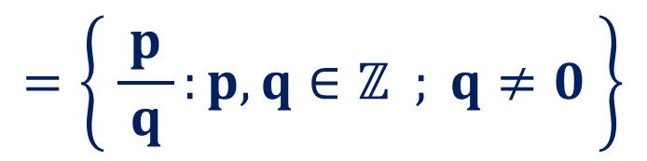








Important Sets
$$ℕ$$
Natural numbers
$$=\left\{ 1, 2, 3,…\right\}$$
$$ℂ$$
$$=\left\{ z=a+ib :a, b∈ℝ \right\}$$
Complex Numbers
Integers
$$ℤ$$
$$=\left\{…,−1, 0, 1,…\right\}$$
Set
$$ℝ$$
$$=ℚ∪ℚ^{c}$$
Real Numbers
Rational Numbers
Irrational Numbers
$$=\left\{ \frac{p}{ q }:p,q∈ℤ ; q≠0 \right\}$$
$$ℚ$$
$$ℚ^{c}$$
Ex. $\sqrt{3},e,π,etc…$

Slide 5

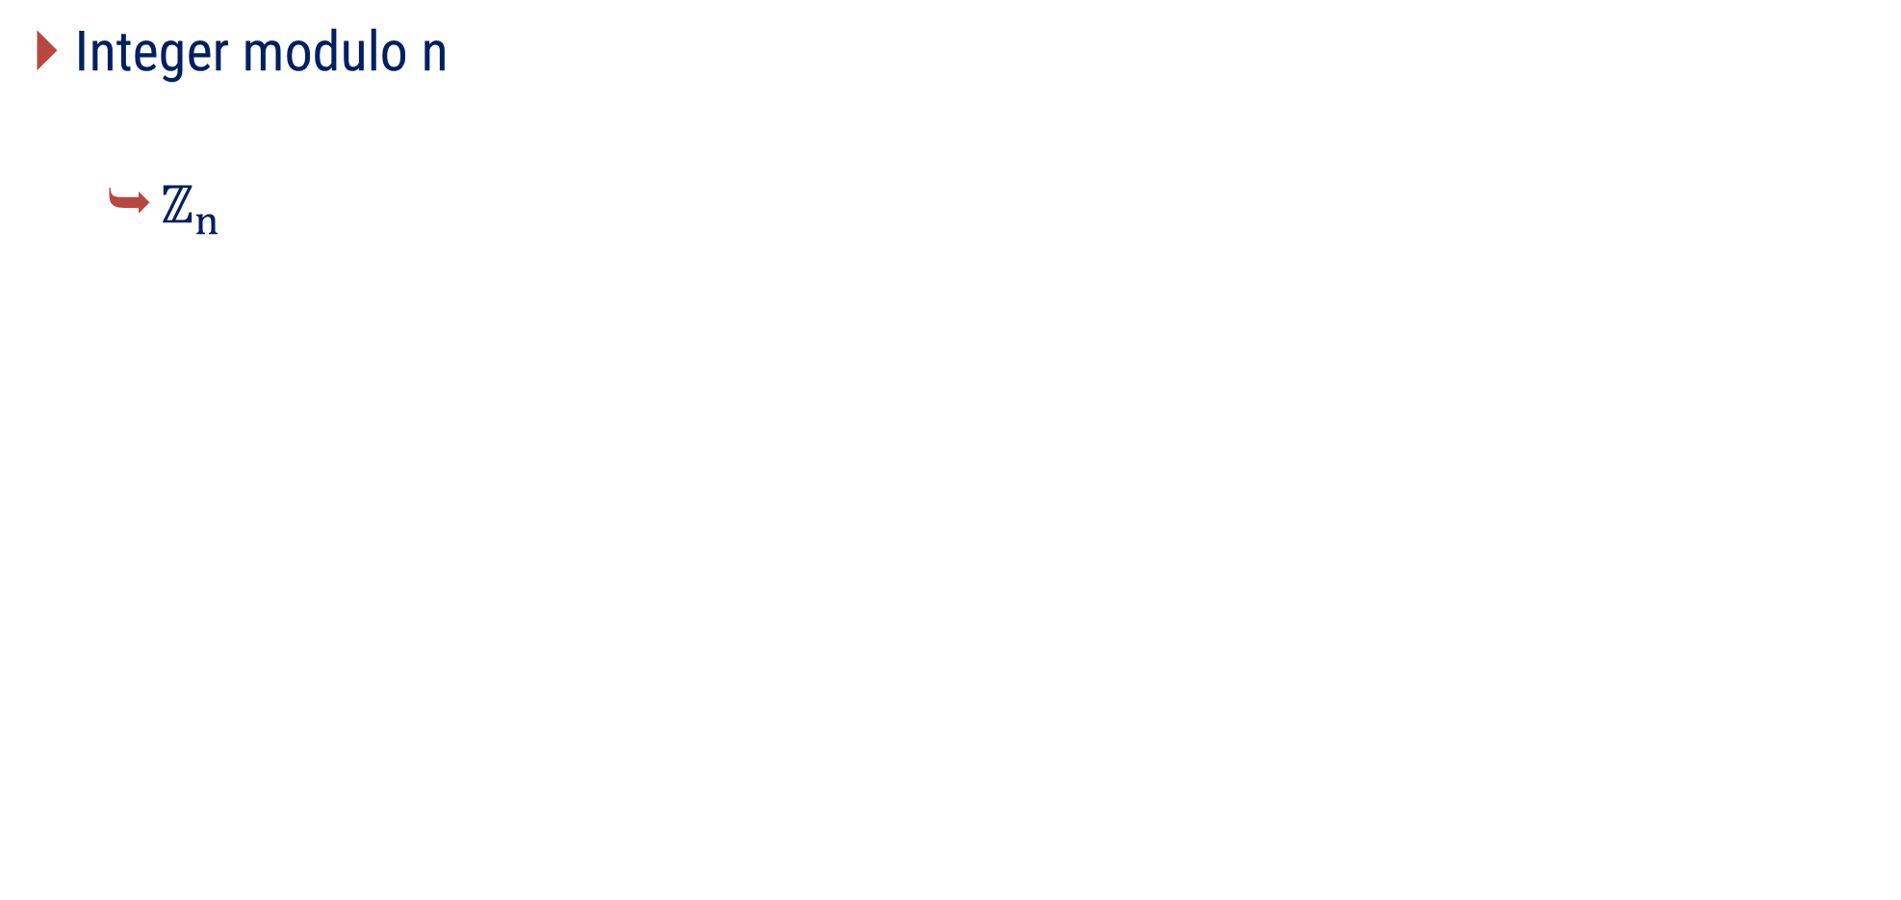
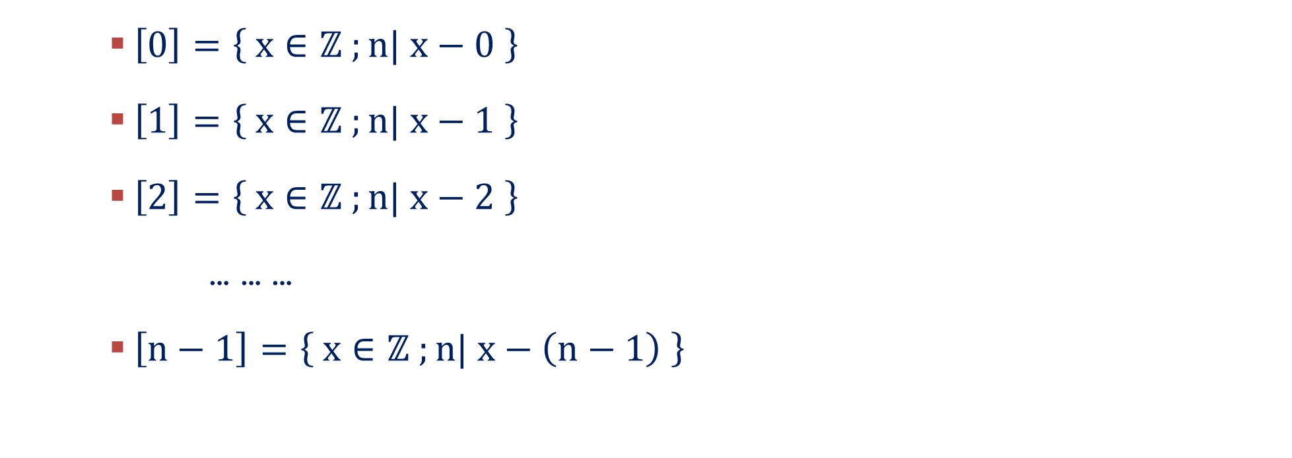
Important Sets
Integer modulo n
$ℤ_{n}$
$$=\left\{ \left[0\right], \left[1\right], \left[2\right],…, \left[n−1\right] \right\}$$
$\left[0\right]=\left\{ x∈ℤ ;n| x−0 \right\}$
$\left[1\right]=\left\{ x∈ℤ ;n| x−1 \right\}$
$\left[2\right]=\left\{ x∈ℤ ;n| x−2 \right\}$
… … …
$\left[n−1\right]=\left\{ x∈ℤ ;n| x−\left(n−1\right) \right\}$

Slide 6
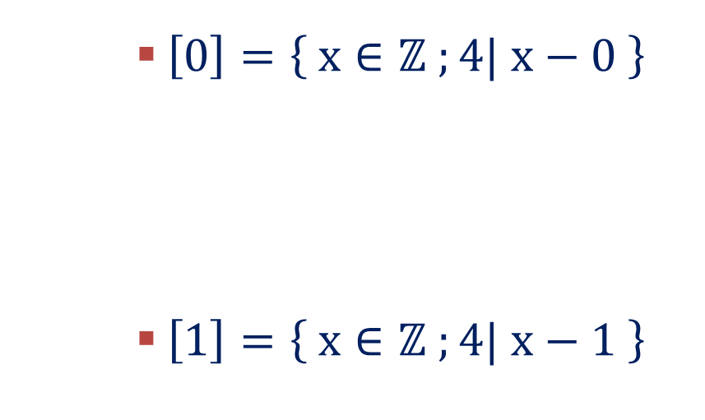



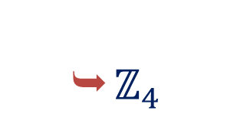
Important Sets
Example
$ℤ_{4}$
$$=\left\{ \left[0\right], \left[1\right], \left[2\right],\left[3\right] \right\}$$
$\left[0\right]=\left\{ x∈ℤ ;4| x−0 \right\}$
$\left[1\right]=\left\{ x∈ℤ ;4| x−1 \right\}$
$$=\left\{x∈ℤ ;x=4k ;k∈ℤ \right\}$$
$$=\left\{…−8, −4, 0, 4, 8,…\right\}$$
$$=\left\{x∈ℤ ;x=4k+1 ;k∈ℤ \right\}$$
$$=\left\{…−7, −3, 1, 5,…\right\}$$

Slide 7

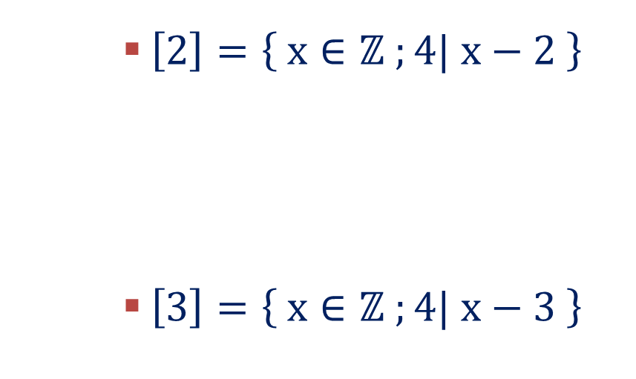

Important Sets
$\left[2\right]=\left\{ x∈ℤ ;4| x−2 \right\}$
$\left[3\right]=\left\{ x∈ℤ ;4| x−3 \right\}$
$$=\left\{x∈ℤ ;x=4k+2 ;k∈ℤ \right\}$$
$$=\left\{…−6, −2, 2, 6,…\right\}$$
$$=\left\{x∈ℤ ;x=4k+3 ;k∈ℤ \right\}$$
$$=\left\{…−5, −1, 3, 7,…\right\}$$

Slide 8

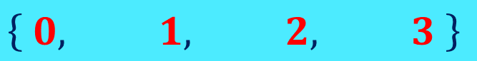




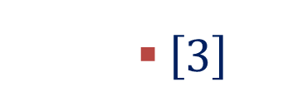
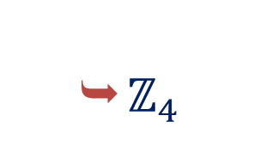
Important Sets
$ℤ_{4}$
$$=\left\{ \left[0\right], \left[1\right], \left[2\right],\left[3\right] \right\}$$
$\left[0\right]$
$$=\left\{…−8, −4, 0, 4, 8,…\right\}$$
$\left[1\right]$
$$=\left\{…−7, −3, 1, 5,…\right\}$$
$\left[2\right]$
$$=\left\{…−6, −2, 2, 6,…\right\}$$
$\left[3\right]$
$$=\left\{…−5, −1, 3, 7,…\right\}$$
$$∴ℤ_{4}=$$
$$\left\{ 0, 1, 2, 3 \right\}$$

Slide 9
Method:1
Binary Operation

Slide 10
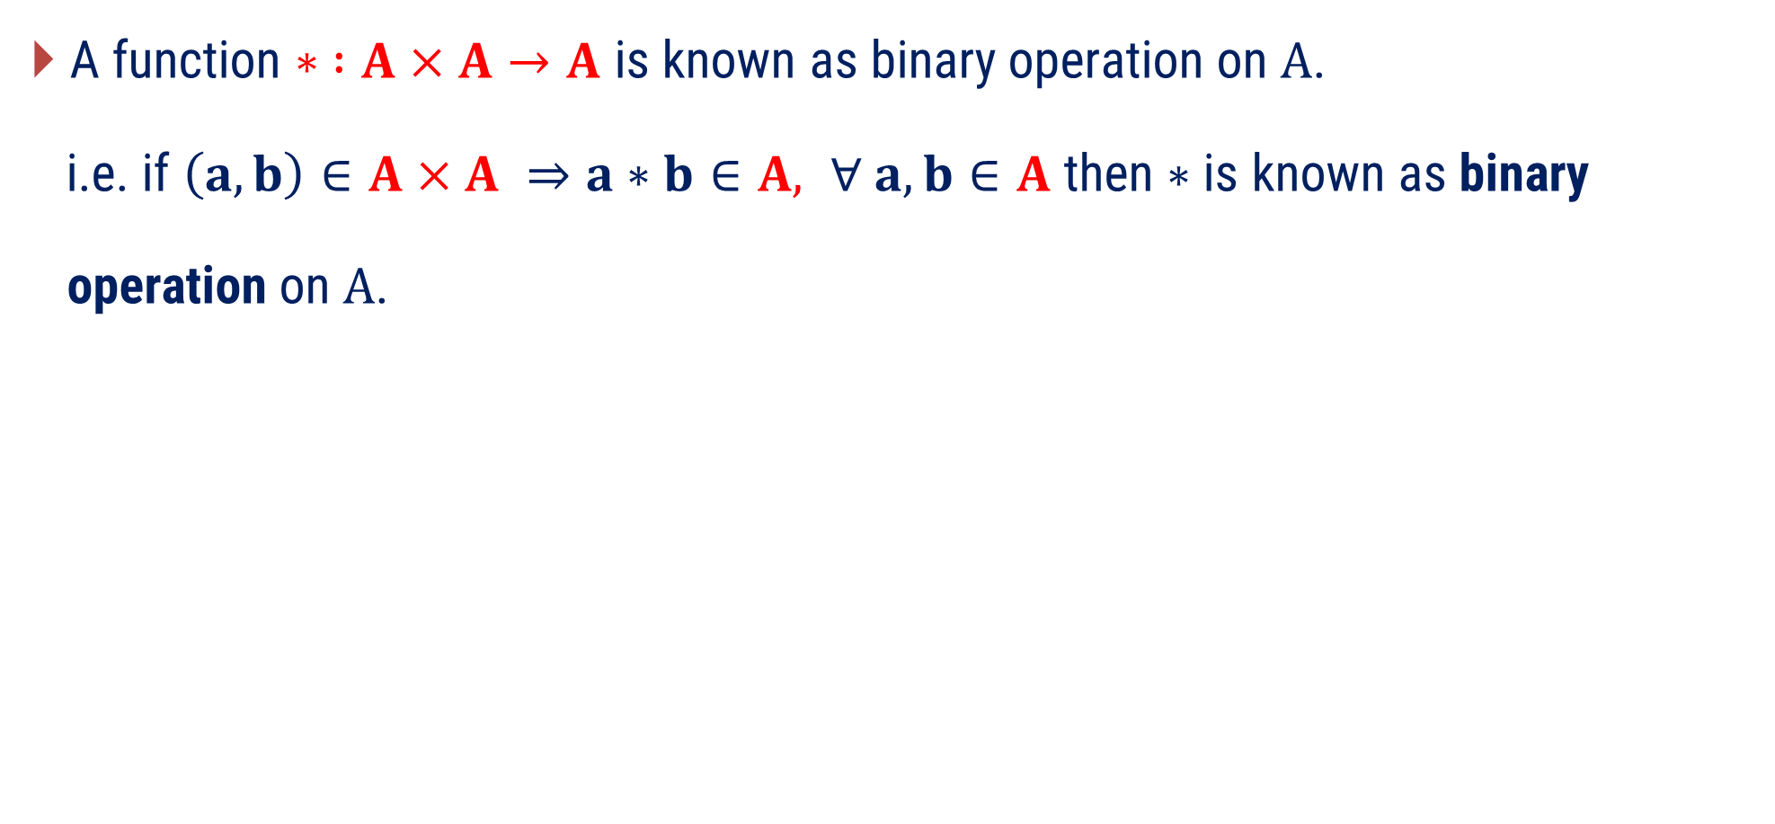
Binary Operation
A function $∗ ∶A×A→A$ is known as binary operation on $A$.
i.e. if $\left(a, b\right)∈A×A ⇒a∗b∈A, ∀ a,b∈A$ then $∗$ is known as binary
operation on $A$.

Slide 11


























Examples of Binary Operation
Binary Operation
Set
Operation
Reason
$$+$$
$$Yes$$
$$∀ a , b ∈ℕ, a+b∈ℕ$$
$$ℕ$$
$$−$$
$$No$$
$$as 2 , 3 ∈ℕ, 2−3=−1∉ℕ$$
$$×$$
$$Yes$$
$$∀ a , b ∈ℕ, a×b∈ℕ$$
$$÷$$
$$No$$
$$as 2 , 3 ∈ℕ, 2÷3∉ℕ$$
$$+$$
$$Yes$$
$$∀ a , b ∈ℤ, a+b∈ℤ$$
$$ℤ$$
$$−$$
$$Yes$$
$$∀ a , b ∈ℤ, a−b∈ℤ$$
$$×$$
$$Yes$$
$$∀ a , b ∈ℤ, a×b∈ℤ$$
$$÷$$
$$No$$
$$as 2 , 3 ∈ℤ, 2÷3∉ℤ$$

Slide 12












Examples of Binary Operation
Binary Operation
Set
Operation
Reason
$$+$$
$$Yes$$
$$∀ a , b ∈ℚ, a+b∈ℚ$$
$$ℚ$$
$$−$$
$$Yes$$
$$∀ a , b ∈ℚ, a−b∈ℚ$$
$$×$$
$$Yes$$
$$∀ a , b ∈ℚ, a×b∈ℚ$$
$$÷$$
$$No$$
$$∀ 0 , 0 ∈ℚ, 0÷0∉ℚ$$
$$+$$
$$Yes$$
$$∀ a , b ∈ℝ, a+b∈ℝ$$
$$ℝ$$
$$−$$
$$Yes$$
$$∀ a , b ∈ℝ, a−b∈ℝ$$
$$×$$
$$Yes$$
$$∀ a , b ∈ℝ, a×b∈ℝ$$
$$÷$$
$$No$$
$$as 2 , 0 ∈ℝ, 2÷0∉ℝ$$

Slide 13

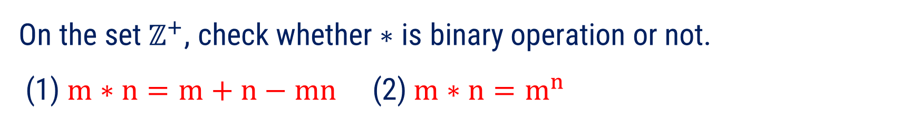



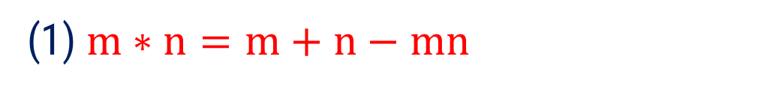
Method 1 $⇛$ Example 1
On the set${ ℤ}^{+}$, check whether$∗$ is binary operation or not.
(1) $m∗n=m+n−mn$ (2) $m∗n=m^{n}$
Question
Solution
(1) $m∗n=m+n−mn$
As we know $ℤ^{+}=$ $\left\{1, 2, 3, …\right\}$
If we take$m=2$ and$n=3$
then $2∗3=2+3−6=−1∉ℤ^{+}$
Hence, $∗$ is not a binary operation on $ℤ^{+}$.

Slide 14

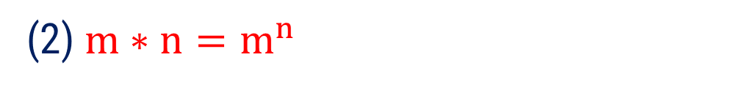
Method 1 $⇛$ Example 1
On the set${ ℤ}^{+}$, check whether$∗$ is binary operation or not.
(1) $m∗n=m+n−mn$ (2) $m∗n=m^{n}$
Question
Solution
(2) $m∗n=m^{n}$
As we know $ℤ^{+}=$ $\left\{1, 2, 3, …\right\}$
Clearly, positive power of positive integer is again a positive integer.
Therefore, $m∗n=m^{n}∈{ ℤ}^{+}$
Hence, $∗$ is a binary operation on $ℤ^{+}$.

Slide 15

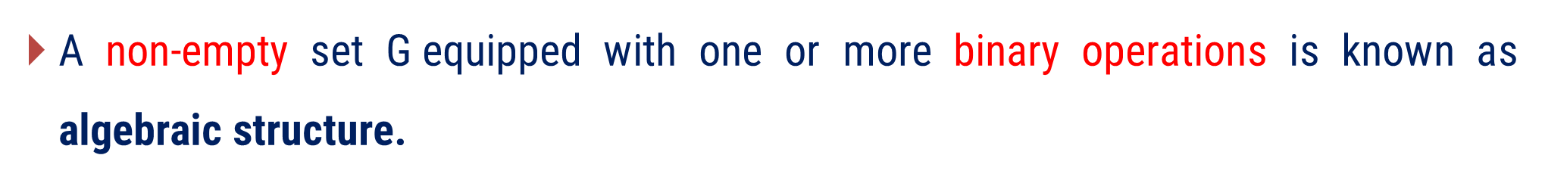
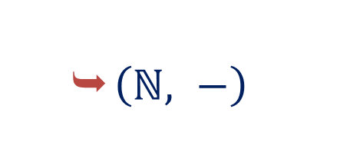
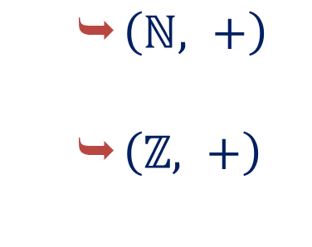
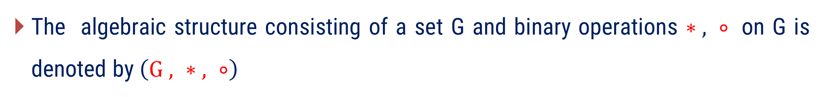
Algebraic Structures
A non-empty set G equipped with one or more binary operations is known as algebraic structure.
The algebraic structure consisting of a set G and binary operations $∗ , ∘$ on G is denoted by $\left(G , ∗ , ∘\right)$
Example
$\left(ℕ, −\right)$
Is not algebraic structure.
$\left(ℕ, +\right)$
$\left(ℤ, +\right)$
Since, $−$ is not binary operation on $ℕ$.

Slide 16
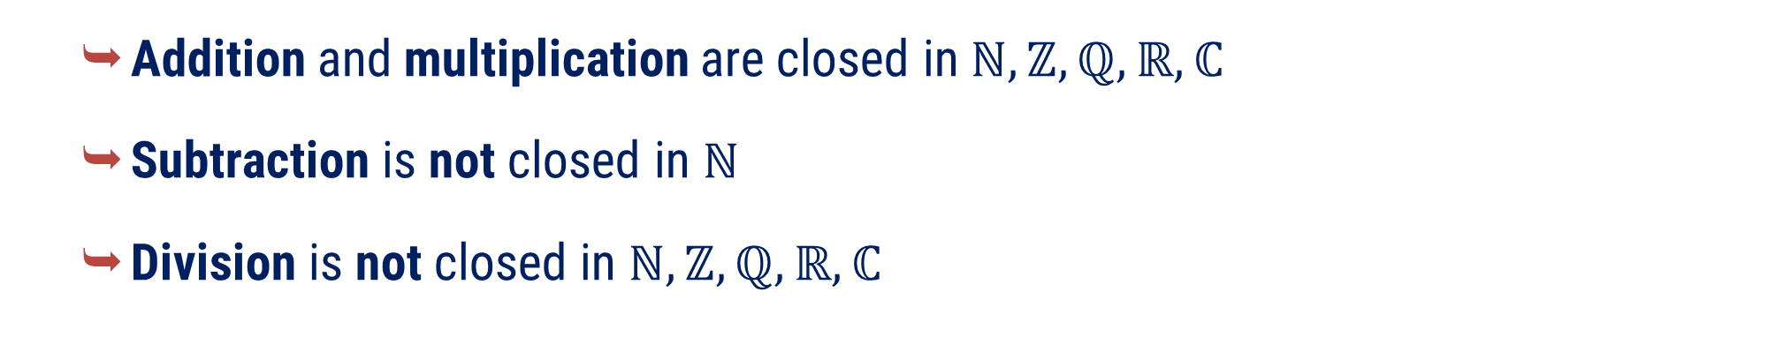
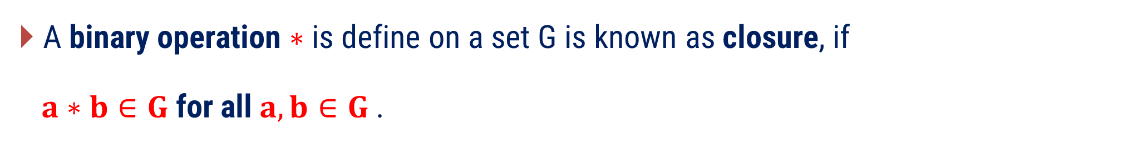
Closure Property
A binary operation $∗$ is define on a set G is known as closure, if
$a∗b∈G$for all$a, b∈G$ .
Example
Addition and multiplication are closed in $ℕ, ℤ, ℚ, ℝ, ℂ$
Subtraction is not closed in $ℕ$
Division is not closed in $ℕ, ℤ, ℚ, ℝ, ℂ$

Slide 17
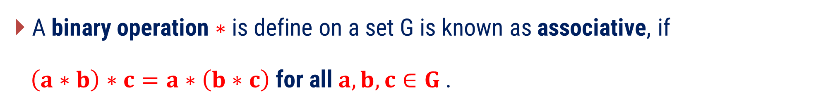
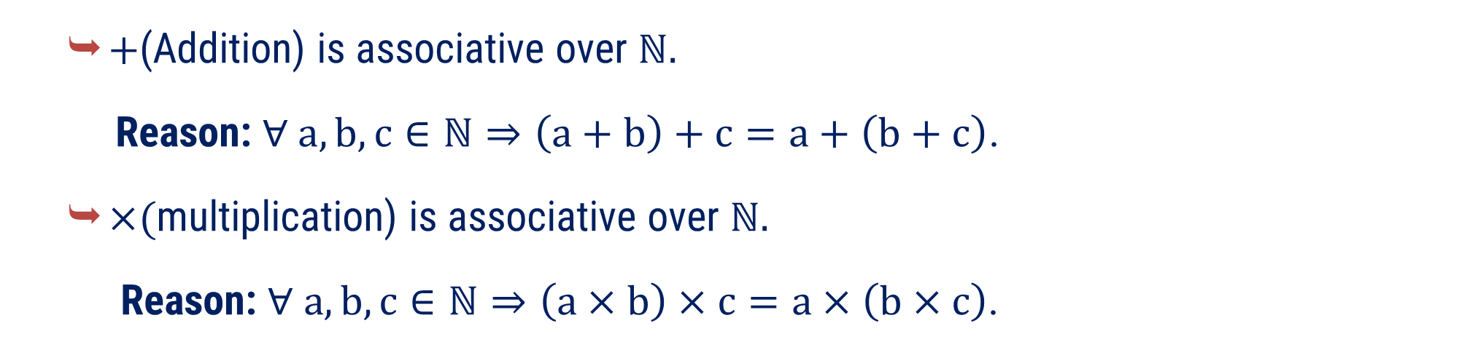
Associative Property
A binary operation $∗$ is define on a set G is known as associative, if
$\left(a∗b\right)∗c=a∗\left(b∗c\right)$ for all$a, b, c∈G$ .
Example
$+$(Addition) is associative over $ℕ$.
Reason: $∀ a, b, c∈ℕ⇒\left(a+b\right)+c=a+\left(b+c\right)$.
$×$(multiplication) is associative over $ℕ$.
Reason: $∀ a, b, c∈ℕ⇒\left(a×b\right)×c=a×\left(b×c\right)$.

Slide 18

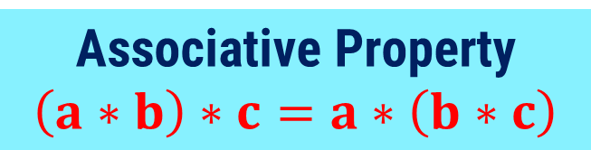
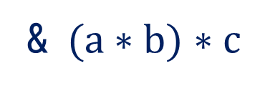
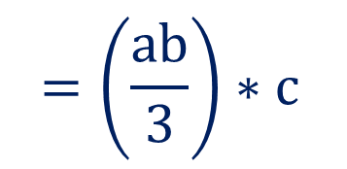
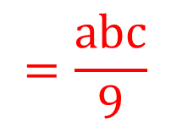
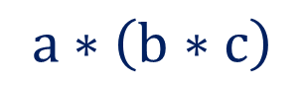
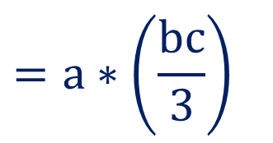
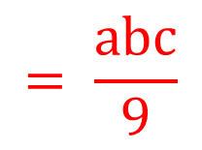
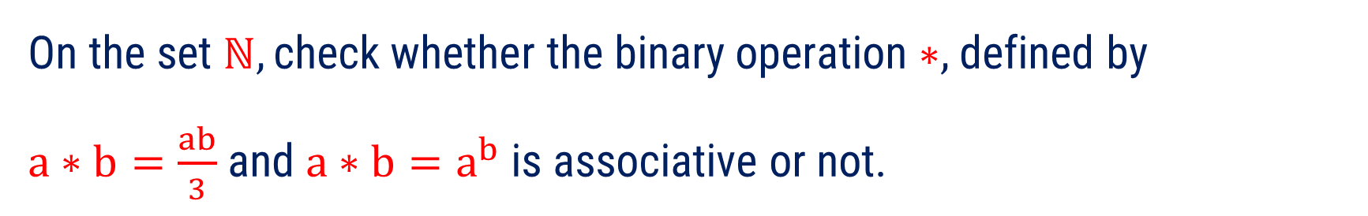

Method 1 $⇛$ Example 2
On the set $ℕ,\text{check} \text{whether} \text{the} \text{binary} \text{operation}∗,$defined by
$a∗b=\frac{ab}{3}$ and $a∗b=a^{b}$ is associative or not.
Question
Solution
(1) Given, $a∗b=\frac{ab}{3} ;∀ a,b∈ ℕ$
Let, $a,b, c∈ ℕ$
Associative Property
$$\left(a∗b\right)∗c=a∗\left(b∗c\right)$$
$$=a∗\left(\frac{bc}{3}\right)$$
$$=\frac{abc}{9}$$
$$a∗\left(b∗c\right)$$
$$=\left(\frac{ab}{3}\right)∗c$$
$$= \frac{abc}{9}$$
& $(a∗b)∗c$
Therefore, $∗$is associative.

Slide 19
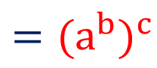
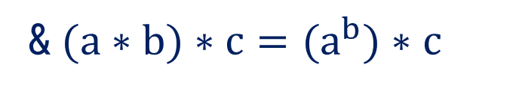
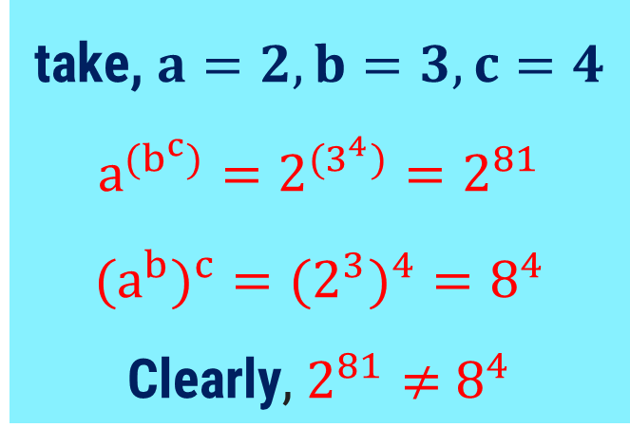
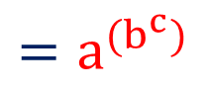
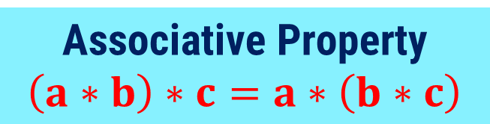
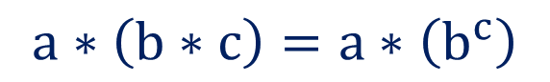



Method 1 $⇛$ Example 3 (Continue)
(2) Given $a∗b=a^{b}$ $;∀ a,b∈ ℕ$
Associative Property
$$\left(a∗b\right)∗c=a∗\left(b∗c\right)$$
Let, $a,b, c∈ ℕ$
$$a∗\left(b∗c\right)=a∗\left(b^{c}\right)$$
$$=a^{{(b}^{c})}$$
& $(a∗b)∗c={(a}^{b})∗c$
$$={{(a}^{b})}^{c}$$
take, $a=2, b=3, c=4$
$$a^{{(b}^{c})}=2^{{(3}^{4})}=2^{81}$$
$${{(a}^{b})}^{c}={{(2}^{3})}^{4}=8^{4}$$
Clearly, $2^{81}≠$ $8^{4}$
but, $a^{{(b}^{c})}$ $≠{{(a}^{b})}^{c}$ ; $∀ a,b,c∈ ℕ$.
Therefore, $a∗b=a^{b}$is not associative.

Slide 20
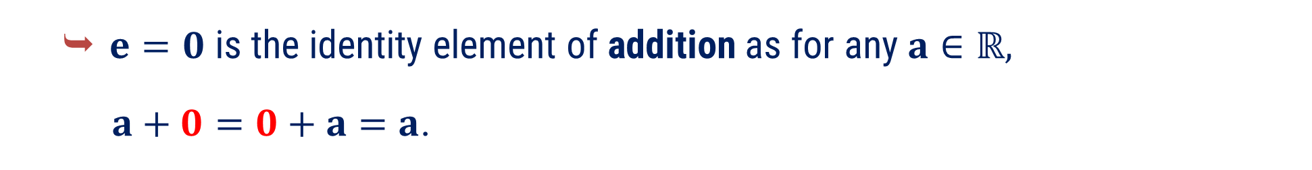
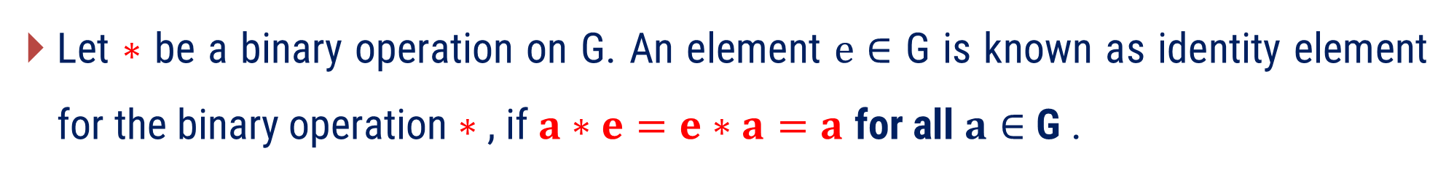
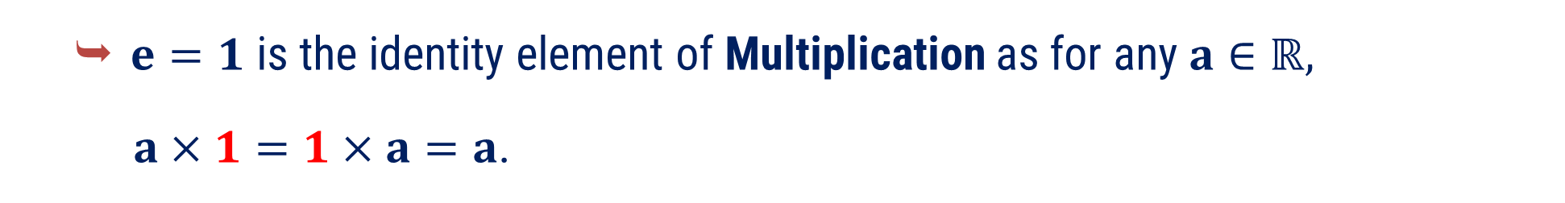
Identity (neutral or unity) Element
Let $∗$ be a binary operation on G. An element $e∈$ G is known as identity element for the binary operation $∗$ , if $a∗e=e∗a=a$ for all $a∈$ G .
Example
$e=0$ is the identity element of addition as for any $a∈ℝ,$
$a+0=0+a=a$.
$e=1$ is the identity element of Multiplication as for any $a∈ℝ,$
$a×1=1×a=a$.

Slide 21
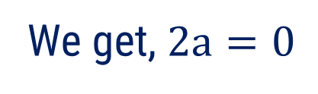

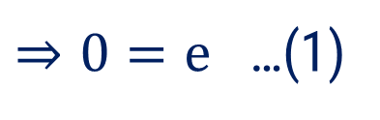
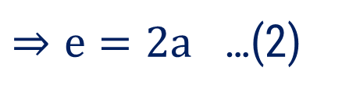




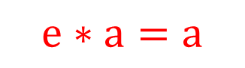
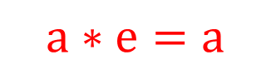
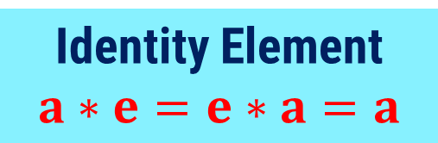
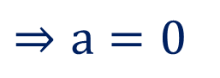
Method 1 $⇛$ Example 3
Question
Let $∗$ be a binary operation on $ℝ$ defined by $a∗b=a−b$, Examine the identity element if exist.
Solution
Suppose , e is the identity element for $∗$
$$a∗e=a$$
$$e∗a=a$$
Identity Element
$$a∗e=e∗a=a$$
$$⇒a−e=a$$
$$⇒e−a=a$$
$$⇒a−a=e$$
$⇒e=2a$ …(2)
$⇒0=e$ …(1)
From equation (1) and (2)
We get, $2a=0$
$⇒a=0$
Which is contradiction.
Therefore $∗$ has no identity element.

Slide 22


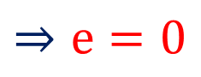
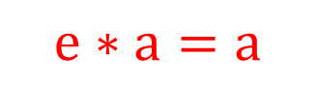
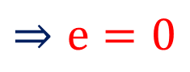

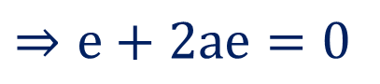


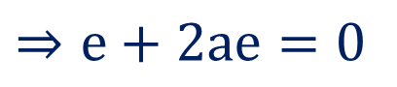
Method 1 $⇛$ Example 4
Question
Let $∗$ be a binary operation on $ℝ$ defined by $a∗b=a+b+2ab$ then find an identity element in $ℝ$ with respect to $∗$.
Solution
Suppose, e is the identity element for $∗$
$$a∗e=a$$
$$e∗a=a$$
Identity Element
$$a∗e=e∗a=a$$
$$⇒a+e+2ae=a$$
$$⇒e+a+2ea=a$$
$$⇒e+2ae=0$$
$$⇒e+2ae=0$$
$$⇒e\left(1+2a\right)=0$$
$$⇒e\left(1+2a\right)=0$$
$$⇒e=0$$
$$⇒e=0$$
Hence, $e=0∈ℝ$ is an identity element of $ℝ$ with respect to $∗$.

Slide 23


Invertible Element (Unit Element)
Let $G$ be a non-empty set. If for each $a∈G$ there exist $b∈G$such that
$a∗b=b∗a=e$ then ‘$b$’ is known as an inverse of $a$ that is $a^{−1}=b$.
Where, ‘$e$’ is an identity element of $G.$
Here, $b$ is also inverse of $a$.
Inverse of identity element is it self.
Example
For addition, Negative of element is inverse of that element.
i.e., $a+b=0$ $⇒a=−b$ ; for all $a,b∈ℝ$

Slide 24









Method 1 $⇛$ Example 5
Let $∗$ be a binary operation on $ℝ$ defined by $a∗b=a+b+2ab$ then which elements has inverse and what are they ?
Question
Solution
Suppose that $a^{−1}=c$ then $a∗c=e=0$
Identity Element
$$e=0$$
$$⇒a∗c=0$$
$$⇒c=\frac{ −a }{ 1+2a }$$
$$⇒a+c+2ac=0$$
Where, $a≠\left(−\frac{ 1 }{ 2 }\right)$
$$⇒c+2ac=−a$$
$$⇒c \left(1+2a\right)=−a$$
i.e. Hence, "each element has inverse in ℝ except $−\frac{1}{2}.$

Slide 25


Commutative Property
A binary operation $∗$ is define on a set G is known as commutative, if
$a∗b =b∗a$ for all$a, b∈G$ .
Example
Any two elements in $ℕ$, $ℤ$, $ℚ$, $ℝ$, and $ℂ$ are commutative under the binary operations addition and multiplication.

Slide 26





Method 1 $⇛$ Example 6
On the set$ℚ$, check whether the binary operation$∗$ is commutative or not. (1)$m∗n=mn+1$ (2) $m∗n=\frac{ m }{n}$
Question
(2) $m∗n=\frac{ m }{n}$
Solution
(1)$m∗n=mn+1$
Let, for any $m,n∈ℚ;$
$$m∗n=\frac{ m }{n} \& n∗m=\frac{ n }{m}$$
Clearly, $\frac{ m }{n}≠$ $\frac{ n }{m}$
i.e. $∗$ is not commutative on the set$ℚ.$
Let, for any $m,n∈ℚ;$
$m∗n=mn+1$
$=nm+1$
$=n∗m$
i.e. $∗$ is commutative on the set$ℚ.$

Slide 27


Composition Table (Cayley Table)
Let ∗ be the binary operation on set $G=\left\{ a_{1}, a_{2}, …,a_{n} \right\}$.
Follow the below steps to make composition table.
Give heading to rows and columns of table as $a_{1}, a_{2}, …,a_{n}$ respectively.
Entry of $a_{i}^{th} raw$ and $a_{j}^{th} column$ is $a_{i}∗a_{j}$.
$$∗$$ | $$a_{1}$$ | $$a_{2}$$ | $$⋯$$ | $$a_{j}$$ | $$⋯$$ | $$a_{n}$$
$$a_{1}$$ | $$a_{1}∗a_{1}$$ | $$a_{1}∗a_{2}$$ | $$⋯$$ | $$a_{1}∗a_{j}$$ | $$⋯$$ | $$a_{1}∗a_{n}$$
$$a_{2}$$ | $$a_{2}∗a_{1}$$ | $$a_{2}∗a_{2}$$ | $$⋯$$ | $$a_{2}∗a_{j}$$ | $$⋯$$ | $$a_{2}∗a_{n}$$
$$⋮$$ | $$⋮$$ | $$⋮$$ | $$⋯$$ | $$⋮$$ | $$⋯$$ | $$⋮$$
$$a_{i}$$ | $$a_{i}∗a_{1}$$ | $$a_{i}∗a_{2}$$ | $$⋯$$ | $$⋮$$ | $$⋯$$ | $$a_{i}∗a_{n}$$
$$⋮$$ | $$⋮$$ | $$⋮$$ | $$⋯$$ | $$⋮$$ | $$⋯$$ | $$⋮$$
$$a_{n}$$ | $$a_{n}∗a_{1}$$ | $$a_{n}∗a_{2}$$ | $$⋯$$ | $$a_{n}∗a_{j}$$ | $$⋯$$ | $$a_{n}∗a_{n}$$

Slide 28


Method 1 $⇛$ Example 8
Question
Let$S=\{ a, b, c, d \}$ and $∗$ be a commutative binary operation on$S$.
Find the missing entries in the following table.
$$∗$$ | $$a$$ | $$b$$ | $$c$$ | $$d$$
$$a$$ | $$b$$ | $$b$$ | $$a$$ | $$d$$
$$b$$ | $$?$$ | $$c$$ | $$c$$ | $$c$$
$$c$$ | $$?$$ | $$?$$ | $$d$$ | $$b$$
$$d$$ | $$?$$ | $$?$$ | $$?$$ | $$a$$

Slide 29




















Method 1 $⇛$ Example 8 (Continue)
Solution
$$∗$$ | $$a$$ | $$b$$ | $$c$$ | $$d$$
$$a$$ | $$b$$ | $$b$$ | $$a$$ | $$d$$
$$b$$ |  | $$c$$ | $$c$$ | $$c$$
$$c$$ |  |  | $$d$$ | $$b$$
$$d$$ |  |  |  | $$a$$
$$b$$
$$a$$
$$c$$
$$d$$
$$c$$
$$b$$
Since, $a∗b=b$
$$⇒b∗a=b$$
(Given that $∗$ is commutative on$S$)
Similarly, $a∗c=a$
$$⇒c∗a=a$$
Similarly, $b∗c=c$
$$⇒c∗b=c$$
Similarly, $b∗d=c$
$$⇒d∗b=c$$
Similarly, $a∗d=d$
$$⇒d∗a=d$$
Similarly, $c∗d=b$
$$⇒d∗c=b$$

Slide 30













Additive Modulo n
For any $a,b∈ℤ,$ additive modulo n is defined as $a{ +}_{n} b=r$ ,
where$r$ is remainder when $a+b$ is divided by n.
It is denoted by $+_{n}$ and read as “Additive modulo n”.
Additive modulo 5 : Let $2, 6∈ℤ, 2 +_{5} 6=3$
Additive modulo 4 : Let $8, 4∈ℤ, 8 +_{4} 4=0$
$$1$$
$2 + 6 = 8$
$$5$$
$$8$$
Example
$$5$$
$$3$$
$$3$$
$$4$$
$$12$$
$8 +4 =12$
$$12$$
$$0$$

Slide 31













Multiplicative Modulo n
For any $a,b∈ℤ$, multiplication modulo n is defined as $a×_{n}b=r$
Where $r$ remainder when $a×b$ is divided by n.
It is denoted by $×_{n}$ and read as “multiplication modulo n”.
Multiplicative modulo 5 : Let $2, 6∈ℤ, 2 ×_{5}6=2$.
Multiplicative modulo 6 : Let $4, 5∈ℤ, 4 ×_{6}5=2$.
$$2$$
$2×6 =12$
$$5$$
$$12$$
Example
$$10$$
$$2$$
$$3$$
$$6$$
$$20$$
$4×5=20$
$$18$$
$$2$$

Slide 32
Method:2
Group, Semigroup and Monoid

Slide 33

Group
Let G be a non-empty set together with a binary operation ‘$∗$’ on $G$,
Then $\left(G, ∗\right)$ is known as a group if the following conditions are satisfied.
Closure Property
Associative Property
Existence of identity element $e$ in $G$
Existence of inverse for each element of $G$

Slide 34



Examples of Group
Example
The set of integers $ℤ$, the set of rational numbers $ℚ$, and the set of real numbers $ℝ$ are all groups under ordinary addition. In each case, the identity is $0$ and the inverse of $a$ is $−a$.
i.e.,
$\left(ℤ, +\right)$
$\left(ℚ, +\right)$
$\left(ℝ,+\right)$
All algebraic structure are Group. With identity element is $0$ and inverse of $a$ is $−a$

Slide 35



















Method 2 $⇛$ Example 1
Show that the set of cube root of unity forms a group under multiplication.
Question
$$⇒ x=1, x=\frac{ −1+i\sqrt{3 } }{ 2 } \& x=\frac{ −1−i\sqrt{3 } }{ 2 }$$
Solution
Here, $x^{3}=1$
$$, ω=\frac{ −1+i\sqrt{3 } }{ 2 } \& ω^{2}=\frac{ −1−i\sqrt{3 } }{ 2 }$$
Consider
Let$,G=\left\{1, ω, ω^{2}\right\}$
Composition table is
$$×$$
$$\begin{matrix} 1 & ω & { ω}^{2} \end{matrix}$$
Claim:
$$\left(G=\left\{1, ω, ω^{2}\right\} , ×\right)$$
is a Group.
$$1$$
$$1$$
$$ω$$
$$ω^{2}$$
$$ω$$
$$ω$$
$$ω^{2}$$
$$1$$
$$ω^{2}$$
$$ω^{2}$$
$$1$$
$$ω$$

Slide 36


















Method 2 $⇛$ Example 1(continue)
$$×$$
$$\begin{matrix} 1 & ω & { ω}^{2} \end{matrix}$$
Solution
By observing Composition table
(1) Closure Property
$$1$$
$$1$$
$$ω$$
$$ω^{2}$$
$$ω$$
$$ω$$
$$ω^{2}$$
$$1$$
From table, any $a, b∈G ⇒a×b∈G$
$$ω^{2}$$
$$ω^{2}$$
$$1$$
$$ω$$
(2) Associative Property
From table, any $a, b, c∈G ⇒a×\left(b×c\right)=\left(a×b\right)×c$
(3) Existence of Identity element
Clearly, $1$ is the identity element of $G$ under multiplication
(4) Existence of Inverse element
$1^{−1}=1$,
$ω^{−1}=ω^{2}$,
${\left(ω^{2}\right)}^{−1}=ω$.

Slide 37
Method 2 $⇛$ Example 1(continue)
Solution
Thus, from (1), (2), (3) and (4) cube roots of unity forms a group with respect to multiplication.

Slide 38





Method 2 $⇛$ Example 2
$$G=\left\{Aα=\left[\begin{matrix}\cos{α} & −sin{α} \\ \sin{α} & \cos{α}\end{matrix}\right] ; α∈ℝ\right\}$$
Question
Show that
is a group under
Matrix multiplication.
Solution
Let $A_{1}, A_{2}, and A_{3}∈G$ where
$$A_{1}=\left[\begin{matrix}\cos{α} & −sin{α} \\ \sin{α} & \cos{α}\end{matrix}\right],$$
$$A_{2}=\left[\begin{matrix}\cos{β} & −sin{β} \\ \sin{β} & \cos{β}\end{matrix}\right],$$
$$A_{3}=\left[\begin{matrix}\cos{γ} & −sin{γ} \\ \sin{γ} & \cos{γ}\end{matrix}\right]$$
(1) Closure Property
$$A_{1}{∙ A}_{2} =\left[\begin{matrix}\cos{α} & −sin{α} \\ \sin{α} & \cos{α}\end{matrix}\right]∙\left[\begin{matrix}\cos{β} & −sin{β} \\ \sin{β} & \cos{β}\end{matrix}\right]$$

Slide 39




Method 2 $⇛$ Example 2 (Continue)
$$A_{1}{∙ A}_{2} =\left[\begin{matrix}\cos{α} & −sin{α} \\ \sin{α} & \cos{α}\end{matrix}\right]∙\left[\begin{matrix}\cos{β} & −sin{β} \\ \sin{β} & \cos{β}\end{matrix}\right]$$
$$=\left[\begin{matrix}(cos{α\cos{β)+(−sin{α}\sin{β)}}} & (−\cos{α\sin{β)+(−sin{α\cos{β)}}}} \\ (\sin{α\cos{β)}+(cos{α\sin{β})}} & (−sin{α\sin{β})+(cos{α\cos{β}}})\end{matrix}\right]$$
$$=\left[\begin{matrix}(cos{α\cos{β−sin{α}\sin{β)}}} & −(cos{α\sin{β−sin{α\cos{β)}}}} \\ \left(\sin{α\cos{β}+\cos{α}\sin{β}}\right) & (\cos{α\cos{β}−sin{α\sin{β}}})\end{matrix}\right]$$
$$=\left[\begin{matrix}cos⁡(α+β) & −sin⁡(α+β) \\ sin⁡(α+β) & cos⁡(α+β)\end{matrix}\right] ∈G$$
i.e. $G$ is closed under matrix multiplication.

Slide 40
Method 2 $⇛$ Example 2 (Continue)
(2) Associative Property
Clearly, $A_{1}⋅ \left(A_{2}⋅A_{3}\right)=\left(A_{1}⋅A_{2}\right) ⋅A_{3}$
(3) Existence of Identity element
Clearly, identity matrix $\left[ \begin{matrix}1 & 0 \\ 0 & 1\end{matrix}\right]$ is the identity element.
(4) Existence of Inverse element
Let, $A_{1}=\left[\begin{matrix}\cos{α} & −sin{α} \\ \sin{α} & \cos{α}\end{matrix}\right]$ be any element of $G ,$

Slide 41


Method 2 $⇛$ Example 2 (Continue)
Let, $A_{1}=\left[\begin{matrix}\cos{α} & −sin{α} \\ \sin{α} & \cos{α}\end{matrix}\right]$ be any element of $G ,$
As, $det\left(A_{1}\right)=\cos^{2}α+\sin^{2}{α=1.}$
Then, $A^{−1}=\left[\begin{matrix}cosα & sinα \\ −sinα & cosα\end{matrix}\right]∈G$
Thus, from above four conditions, $G$ is a group.

Slide 42

Method 2 $⇛$ Example 3 (note : $ℤ_{n}^{∗}$ = $ℤ_{n}−\{0\}$ )
Check whether
is a group or not ?
Question
($ℤ_{5}^{∗}$, $×_{5}$)
Solution
Here $ℤ_{5}^{∗}=\left\{\left[1\right], \left[2\right], \left[3\right], \left[4\right]\right\}=\{1, 2, 3, 4\}$
$$\left[1\right]=\{…, −9, −4, 1, 6, 11, …\}$$
$$\left[2\right]=\{…, −8, −3, 2, 7, 12, …\}$$
$$\left[3\right]=\{…, −7, −2, 3, 8, 13, …\}$$
$$\left[4\right]=\{…, −6, −1, 4, 9, 14, …\}$$

Slide 43





Method 2 $⇛$ Example 3 (Continue) (note : $ℤ_{n}^{∗}$ = $ℤ_{n}−\{0\}$ )
Composition Table
$ℤ_{5}^{∗}=\{1, 2, 3, 4\}$
1 2 3 4
From composition table we observe that,
$$×­_{5}$$
1 2 3 4
(1) Closure Property
1
2
2 4 1 3
For any $a,b∈ℤ_{5}^{∗}⇒a×­_{5} b∈ℤ_{5}^{∗}$
3
3 1 4 2
(2) Associative Property
4
4 3 2 1
For any $a,b, c∈ℤ_{5}^{∗}$
$$⇒a×­_{5}\left(b×­_{5} c\right)=\left(a×­_{5} b\right)×­_{5} c$$

Slide 44







Method 2 $⇛$ Example 3 (Continue) (note : $ℤ_{n}^{∗}$ = $ℤ_{n}−\{0\}$ )
(3) Existence of Identity element
$ℤ_{5}^{∗}=\{1, 2, 3, 4\}$
Clearly, $1∈ℤ_{5}^{∗}$ is an identity element of $ℤ_{5}^{∗}$
with respect to $×­_{5}$.
$$×­_{5}$$
1 2 3 4
1234
1 2 3 4
(4) Existence of Inverse element
2 4 1 3
$$1^{−1}=1$$
$$3^{−1}=2$$
3 1 4 2
4 3 2 1
$$2^{−1}=3$$
$$4^{−1}=4$$
Thus, from above four conditions, $\left(ℤ_{5}^{∗}, { ×}_{5}\right)$ is a group.

Slide 45



Method 2 $⇛$ Example 4
Check whether
is a group or not ?
Question
$$G=\left(\left\{5, 15, 25, 35\right\}, ×_{40}\right)$$
Solution
Here, $G=\left(\left\{5, 15, 25, 35\right\}, ×_{40}\right)$
Composition Table
$$×­_{40}$$
5 15 25 35
5
25 35 5 15
15
35 25 15 5
25
5 15 25 35
35
15 5 35 25

Slide 46




Method 2 $⇛$ Example 4 (Continue)
From composition table we observe that,
$$×­_{40}$$
5 15 25 35
(1) Closure Property
5
25 35 5 15
For any $a,b∈G⇒a×­_{40} b∈G$
15
35 25 15 5
(2) Associative Property
25
5 15 25 35
35
15 5 35 25
For any $a,b, c∈G$
$$⇒a×­_{40}\left(b×­_{40} c\right)=\left(a×­_{40} b\right)×­_{40} c$$
(3) Existence of Identity element
From composition table we observe that, $25$ is the identity element.

Slide 47








Method 2 $⇛$ Example 4 (Continue)
(4) Existence of Inverse element
$$×­_{40}$$
5 15 25 35
$${25}^{−1}=25$$
as$25$is the identity element
5
25 35 5 15
15
35 25 15 5
$$5^{−1}=5$$
$\left(∵\text{ 5 }×­_{40}\text{ 5 } \text{=} \text{ 25 }\right)$
25
5 15 25 35
$${15}^{−1}=15$$
$\left(∵ \text{1}\text{5 }×­_{40} \text{1}\text{5 } \text{=} \text{ 25 }\right)$
35
15 5 35 25
$${35}^{−1}=35$$
$\left(∵ \text{3}\text{5 }×­_{40} \text{3}\text{5 } \text{=} \text{ 25 }\right)$
Thus, from above four conditions, $G$ is a group.

Slide 48


Semigroup
Let G be a non-empty set together with a binary operation ‘$∗$’ on $G$,
Then $\left(G, ∗\right)$ is known as a semigroup if the following conditions are satisfied.
Closure Property
Associative Property
One thing is clear that all group are semigroup.
Example
$\left(ℕ,+\right)$
$\left(ℤ^{+}, +\right)$

Slide 49





Method 2 $⇛$ Example 5
Let $∗$ be a binary operation on $ℝ$ defined by $a∗b=a+b+2ab$ is $\left(ℝ, ∗\right)$ semigroup?
Question
Solution
Given that, $a∗b=a+b+2ab$
Closure Property
Let $a, b∈ℝ,$
$$a∗b=a+b+2ab∈ℝ$$
$∴ℝ$ is closed under $∗$

Slide 50


Method 2 $⇛$ Example 5 (Continue)
Associative Property
$$a∗b=a+b+2ab$$
L.H.S.$=a∗\left(b∗c\right)$
L.H.S.$=a∗\left(b+c+2bc\right)$
L.H.S.$=$ $a+b+c+2bc+2a\left(b+c+2bc\right)$
L.H.S.$=$ $a+b+c+2bc+2ab+2ac+4abc$
L.H.S.$=a+b+c+2ab+2bc+2ac+4abc$.

Slide 51



Method 2 $⇛$ Example 5 (Continue)
Associative Property
$$a∗b=a+b+2ab$$
R.H.S.$=(a∗b)∗c$
$=\left(a+b+2ab\right)∗c$
$=$ $a+b+2ab+c+2\left(a+b+2ab\right)c$
$=a+b+c+2ab+2ac+2bc+4abc$
$$=a+b+c+2ab+2bc+2ac+4ab$$
i.e. $∗$ is associative over $ℝ$.
Hence, $\left(ℝ, ∗\right)$ is a semigroup.

Slide 52


Monoid
Let G be a non-empty set together with a binary operation ‘$∗$’ on $G$,
Then $\left(G, ∗\right)$ is known as a monoid if the following conditions are satisfied.
Closure Property
Associative Property
Existence of identity
One thing is clear that all group are monoid.
Example
$\left(ℕ, ×\right)$

Slide 53









All Definitions Together
Let $G$ be a non-empty set and ‘∗’ be an operation define on $G$.
$G$ is closed under ‘∗’.
(G, $∗$) is Semi Group
(G, $∗$) is Monoid
‘∗’ is associative over $G$.
(G, $∗$) is Commutative Group
OR
Abelian Group
(G, $∗$) is Group
There exist an identity element of $G$ under ‘∗’.
There exist an inverse for each element of $G$ under ‘∗’.
‘∗’ is commutative over $G$.

Slide 54




















Think !
Question
Check whether the following algebraic structures are Abelian group or not.
$\left(1\right) \left(ℕ, +\right)$
$\left(6\right) \left(ℕ,×\right)$
$\left(11\right) \left(\left\{1\right\}, ×\right)$
$$\left(16\right) \left(ℤ_{4}, ×_{4}\right)$$
$$\left(2\right) \left(ℤ, +\right)$$
$$\left(7\right) \left(ℤ,×\right)$$
$$\left(12\right) \left(\left\{−1,1\right\},×\right)$$
$$\left(17\right) \left(ℤ_{7}, ×_{7}\right)$$
$$\left(3\right) \left(ℚ,+\right)$$
$$\left(8\right) \left(ℚ,×\right)$$
$$\left(13\right) \left(ℚ−\left\{0\right\},×\right)$$
$$\left(18\right) \left(ℤ_{4}, +_{4}\right)$$
$$\left(4\right) \left(ℝ,+\right)$$
$$\left(9\right) \left(ℝ,×\right)$$
$$\left(14\right) \left(ℝ−\left\{0\right\},×\right)$$
$$\left(19\right) \left(ℤ_{7}, +_{7}\right)$$
$$\left(5\right) \left(ℂ,+\right)$$
$$\left(10\right) \left(ℂ,×\right)$$
$$\left(15\right) \left(ℂ−\left\{0\right\},×\right)$$
$$\left(20\right) \left(ℤ_{8}, ×_{8}\right)$$

Slide 55
Method:3
sub group

Slide 56

Subgroup
Let $\left(G, ∗\right)$ be a group and H be non empty subset of $G$. If $\left(H, ∗\right)$ forms a group then $H$ is a subgroup of $G$. it is denoted as $H≤G.$
For any group $G$, $H_{1}=\left\{e_{1}\right\}$ and $H_{2}=G$ are always subgroup of $G$.
$\left(ℤ,+\right)≤\left(ℚ,+\right)$
$\left(ℚ,+\right)≤\left(ℝ,+\right)$
$\left(ℝ,+\right)≤\left(ℂ,+\right)$
Examples

Slide 57

Subgroup (Important Notes)
(1) Every group has at least two subgroup (improper subgroup ).
Which are (1) identity & (2) Group itself.
(2) If $H_{1}$ and $H_{2}$ are two subgroups of a group G, then $H_{1}$∩ $H_{2}$ is also a
subgroup of G.
(3) The union of two subgroups is not necessarily a subgroup.

Slide 58



Method 3 $⇛$ Example 1
Question
Find all subgroups of ($ℤ_{12}, +_{12}$) .
We know that $ℤ_{12}=\{0, 1, 2, 3, 4, 5, 6, 7, 8, 9, 10, 11\}$
Solution
Step - 1
$H_{1}= \left\langle 0 \right\rangle =\left(0,{ +}_{12}\right)$ & $H_{2}=\left(ℤ_{12},{ +}_{12}\right)$
Step - 2
Divisor of $12$ : $1, 2, 3, 4, 6, 12$
Step - 3
Make subgroup of order $1, 2, 3, 4, 6, 12$

Slide 59












Method 3 $⇛$ Example 1 (Continue)
Step - 3
Make subgroup of order $1, 2, 3, 4, 6, 12$
$$H_{3}=\left\langle 1 \right\rangle$$
Process :
$$1^{1}=1$$
$$1^{2}=$$
$$1+_{12}1$$
$$=2$$
$$1^{3}=$$
$$1+_{12}1+_{12}1$$
$$=3$$
$$1^{4}=$$
$$1+_{12}1+_{12}1+_{12}1$$
$$=4$$

Slide 60












Method 3 $⇛$ Example 1 (Continue)
Process :
$$1^{5}=$$
$$1+_{12}1+_{12}1+_{12}1+_{12}1$$
$$=5$$
$$1^{6}=$$
$$1+_{12}1+_{12}1+_{12}1+_{12}1+_{12}1$$
$$=6$$
$$1^{7}=$$
$$1+_{12}1+_{12}1+_{12}1+_{12}1+_{12}1+_{12}1$$
$$=7$$
$$1^{8}=$$
$$1+_{12}1+_{12}1+_{12}1+_{12}1+_{12}1+_{12}1+_{12}1$$
$$=8$$
$$1^{9}=$$
$$1+_{12}1+_{12}1+_{12}1+_{12}1+_{12}1+_{12}1+_{12}1+_{12}1$$
$$=9$$

Slide 61









Method 3 $⇛$ Example 1 (Continue)
Process :
$$1^{10}=$$
$$1+_{12}1+_{12}1+_{12}1+_{12}1+_{12}1+_{12}1+_{12}1+_{12}1+_{12}1$$
$$=10$$
$$1^{11}=$$
$$1+_{12}1+_{12}1+_{12}1+_{12}1+_{12}1+_{12}1+_{12}1+_{12}1+_{12}1+_{12}1$$
$$=11$$
$$1^{12}=12$$
$$=0$$
$${∴H}_{3}=\left\langle 1 \right\rangle$$
$$=\left\{0, 1, 2, 3, 4, 5, 6, 7, 8, 9, 10, 11\right\}$$
$$=ℤ_{12}$$

Slide 62


















Method 3 $⇛$ Example 1 (Continue)
$$H_{4}=\left\langle 2 \right\rangle$$
$$=\left\{0, 2, 4, 6, 8, 10\right\}$$
Process :
$$2^{1}=2$$
$$2^{2}=$$
$$2+_{12}2$$
$$=4$$
$$2^{3}=$$
$$2+_{12}2+_{12}2$$
$$=6$$
$$2^{4}=$$
$$2+_{12}2+_{12}2+_{12}2$$
$$=8$$
$$2^{5}=$$
$$2+_{12}2+_{12}2+_{12}2+_{12}2$$
$$=10$$
$$2^{6}=$$
$$2+_{12}2+_{12}2+_{12}2+_{12}2+_{12}2$$
$$=12$$
$$=0$$

Slide 63














Method 3 $⇛$ Example 1 (Continue)
$$H_{5}=\left\langle 3 \right\rangle$$
Process :
$$3^{1}=3$$
$$3^{2}=$$
$$3+_{12}3$$
$$=6$$
$$3^{3}=$$
$$3+_{12}3+_{12}3$$
$$=9$$
$$3^{4}=$$
$$3+_{12}3+_{12}3+_{12}3$$
$$=12$$
$$=0$$
$$H_{5}=\left\langle 3 \right\rangle$$
$$=\left\{0, 3, 6, 9\right\}$$

Slide 64











Method 3 $⇛$ Example 1 (Continue)
$$H_{6}=\left\langle 4 \right\rangle$$
Process :
$$4^{1}=4$$
$$4^{2}=$$
$$4+_{12}4$$
$$=8$$
$$4^{3}=$$
$$4+_{12}4+_{12}4$$
$$=12$$
$$=0$$
$$H_{4}=\left\langle 4 \right\rangle$$
$$=\left\{0, 4, 8\right\}$$

Slide 65








Method 3 $⇛$ Example 1 (Continue)
$$H_{5}=\left\langle 6 \right\rangle$$
Process :
$$6^{1}=6$$
$$6^{2}=$$
$$6+_{12}6$$
$$=12$$
$$=0$$
$$H_{5}=\left\langle 6 \right\rangle$$
$$=\left\{0, 6\right\}$$

Slide 66




Method 3 $⇛$ Example 2
Question
Show that $(\left\{1, 4, 13, 16\}, ×_{17} \right\})$is a subgroup of $\left(ℤ_{17}^{∗},{ ×}_{17}\right).$
Solution
W.K.T $ℤ_{17}^{∗}=\{1, 2, 3, … , 16\}$
Clearly, here $\{1, 4, 13, 16\}⊂ℤ_{17}^{∗}$
$\left\{1, 4, 13, 16\right\}=$ H (Say)
Claim : $H≤ℤ_{17}^{∗}$
Composition Table
$$×_{17}$$
1 4 13 16
1 4
13
16
1 4 13 16
4 16 1 13
13 1 16 4
16 13 4 1

Slide 67




Method 3 $⇛$ Example 2
(1) Closure Property
$$×_{17}$$
1 4 13 16
For any $a,b∈H⇒a×­_{17} b∈H$
1 4
13
16
1 4 13 16
(2) Associative Property
4 16 1 13
For any $a,b, c∈H$
13 1 16 4
$$⇒a×­_{17}\left(b×­_{17} c\right)=\left(a×­_{17} b\right)×­_{17} c$$
16 13 4 1
(3) Existence of Identity element
Clearly 1 is the identity element of $\left(\left\{1, 4, 13, 16\right\}, ×_{17}\right)$

Slide 68





Method 3 $⇛$ Example 2 (Continue)
(4) Existence of Inverse element
$$×_{17}$$
1 4 13 16
1 4
13
16
$$1^{−1}=1$$
$${16}^{−1}=16$$
1 4 13 16
$$4^{−1}=13$$
$${13}^{−1}=4$$
4 16 1 13
Thus, from the above conditions,
$\left(\left\{1, 4, 13, 16\right\}, ×_{17}\right)$ is a subgroup of $\left(ℤ_{17}^{∗},×_{17}\right)$ .
13 1 16 4
16 13 4 1

Slide 69
Method:4
Abelian Group

Slide 70

Abelian Group (Commutative Group)
Let G be a non-empty set together with a binary operation ‘$∗$’ on $G$,
Then $\left(G, ∗\right)$ is known as a group if the following conditions are satisfied.
Closure Property
Associative Property
Existence of identity element $e$ in $G$
Existence of inverse for each element of $G$
Commutative Property

Slide 71











Method 4 $⇛$ Example 1
Question
Show that $\left(ℚ^{+} , ∗\right)$ forms an Abelian group. Where,$∗$ defined by $a∗b=\frac{ ab }{ 2 }$ $∀ a,b∈ℚ^{+}$ .
Solution
(1) Closure Property
(2) Associative Property
for any$a,b∈ℚ^{+}$,
Claim: for any$a,b,c∈ℚ^{+}$, $a∗\left(b∗c\right)=\left(a∗b\right)∗c$
$$a∗b=\frac{ ab }{ 2 }∈ℚ^{+}$$
L.H.S$=a∗\left(b∗c\right)$
$$=a∗\left(\frac{ bc }{ 2 }\right)$$
$$=\frac{ abc }{ 4 }$$
L.H.S $=$ R.H.S
$⇒ℚ^{+}$ is closed under $∗$.
$$=\left(\frac{ ab }{ 2 }\right)∗c$$
$$=\frac{ abc }{ 4 }$$
R.H.S$=\left(a∗b\right)∗c$

Slide 72










Method 4 $⇛$ Example 1 (continue)
(3) Existence of Identity element
(4) Existence of Inverse element
$∃ e∈ℚ^{+}$such that $a∗e=a,∀a∈ℚ^{+}$
Suppose that $a^{−1}=c$ then
$$a∗c=e=2$$
$$⇒\frac{ ae }{ 2 }=a$$
$$⇒a∗c=2$$
$$⇒e=2$$
$$⇒\frac{ ac }{ 2 }=2$$
Hence, $e=2∈ℚ^{+}$is an identity element of $ℚ^{+}$ with respect to $∗$.
$$⇒c =\frac{ 4 }{a}∈ℚ^{+}$$
$$∴a^{−1}=c=\frac{ 4 }{ a }$$
is an inverse of $a$ from $ℚ^{+}$.

Slide 73






Method 4 $⇛$ Example 1 (continue)
(5) Commutative Property
Claim:
$$∀ a,b∈ℚ^{+}⇒a∗b=b∗a$$
L.H.S.$=a∗b$
$$=\frac{ ab }{ 2 }$$
$$=\frac{ ba }{ 2 }$$
$=$ R.H.S
Hence, from above five conditions…
$\left(ℚ^{+} , ∗\right)$ is a commutative group.

Slide 74

Method 4 $⇛$ Example 2
Question
Show that
$$\left(ℤ_{6}, +_{6}\right)$$
is an Abelian group.
Solution
Here, $ℤ_{6}=\left\{\left[0\right], \left[1\right], \left[2\right], \left[3\right], \left[4\right], \left[5\right]\right\}=\{0, 1, 2, 3, 4, 5\}$
$$\left[0\right]=\{…, −12, −6, 0, 6, 12, …\}$$
$$\left[1\right]=\{…, −11, −5, 1, 7, 13, …\}$$
$$\left[2\right]=\{…, −10, −4, 2, 8, 14, …\}$$
$$\left[3\right]=\{…, −9, −3, 3, 9, 15, … \}$$
$$\left[4\right]=\{…, −8, −2, 4, 10, 16, …\}$$
$$\left[5\right]=\{…, −7, −1, 5, 11, 17, …\}$$

Slide 75


Method 4 $⇛$ Example 2 (Continue)
Composition Table
$$ℤ_{6}=\{ 0, 1, 2, 3, 4, 5 \}$$
$$+­_{6}$$
0 1 2 3 4 5
0
0 1 2 3 4 5
1
1 2 3 4 5 0
2
2 3 4 5 0 1
3
3 4 5 0 1 2
4
4 5 0 1 2 3
5
5 0 1 2 3 4

Slide 76



Method 4 $⇛$ Example 2 (continue)
From composition table we observe that,
(1) Closure Property
For any $a,b∈ℤ_{6}⇒a+_{6}b∈ℤ_{6}$
(2) Associative Property
For any $a,b, c∈ℤ_{6}$
$⇒a+_{6}\left(b+_{6}c\right)=\left(a+_{6}b\right)$ $+_{6} c$
(3) Existence of Identity element
Clearly, $0∈ℤ_{6}$ is an identity element of $ℤ_{6}$ with respect to $+_{6}$.

Slide 77








Method 4 $⇛$ Example 2 (continue)
(4) Existence of Inverse element
$$0^{−1}=0$$
$$2^{−1}=4$$
$$4^{−1}=2$$
$$1^{−1}=5$$
$$3^{−1}=3$$
$$5^{−1}=1$$
(5) Commutative Property
For any $a,b∈ℤ_{6}$
$$⇒\left(a+_{6}b\right)=\left(b+_{6}a\right)$$
Hence, from above five condition $\left(ℤ_{6}, +_{6}\right)$ is an Abelian group.

Slide 78
Method:5
Order of Group and Order of Elements

Slide 79

Order of a Group
The number of elements of a group is known as order of group.
We will use$|G|$ to denote the order of$G$.
If group $G=\left(ℤ, +\right)$ then$\left|G\right|=∞$.
If group $G=\left(ℤ_{n}, { +}_{n}\right)$ then$\left|G\right|=n$.
If group $G=\left(ℚ−\left\{0\right\}, ×\right)$ then$\left|G\right|=∞$.
If group$G$ is the set of cube root of unity under multiplication
then, $\left|G\right|=3$.
Example

Slide 80

Order of an elements
The order of an element a in group$G$ is the smallest positive integer$n$
such that$a^{n}=e$. (In additive notation, this would be$na=0$.)
If no such integer exists, we say that$a$ has infinite order.
The order of an element$a$ is denoted by$| a |$.
The order of identity element is always 1.

Slide 81













Method 5 $⇛$ Example 1
Question
Find order of each elements of ($ℤ_{10}$, $+_{10}$)
Solution
Here $ℤ_{10}=\left\{\left[0\right], \left[1\right], \left[2\right], \left[3\right], \left[4\right], \left[5\right], \left[6\right], \left[7\right], \left[8\right], \left[9\right]\right\}$
$=\left\{0, 1, 2, 3, 4, 5, 6, 7, 8, 9\right\}$
$\left|0\right|=$ 1 as 0 is the identity element
Order of 1
$n⋅1=0$ $; n∈ℤ^{+}$
I.e., one time one
$$n=1⇒$$
$$1⋅1$$
$$=1$$
$$≠0$$
I.e., Two times one
$$n=2⇒$$
$$2⋅1$$
$$=1+_{10}1$$
$$=2$$
$$≠0$$

Slide 82












































Method 5 $⇛$ Example 1 (Continue)
Order of 2
$$n=3$$
$$⇒3⋅1$$
$$=1+_{10}1+_{10}1$$
$$=3$$
$$≠0$$
$$n=4$$
$$⇒4⋅1$$
$=1+_{10}1+_{10}1$ $+_{10}1$
$$=4$$
$$≠0$$
$n+_{10}2=0$ $; n∈ℤ^{+}$
$$n=5$$
$$⇒5⋅1$$
$=1+_{10}1+_{10}1$ $+_{10}1$ $+_{10}1$
$$=5$$
$$≠0$$
$$n=5⇒5+_{10}1=5≠0$$
$$n=2⇒2+_{10}2=4≠0$$
$$n=6$$
$$⇒6⋅1$$
$=1+_{10}1+_{10}1$ $+_{10}1$ $+_{10}1$ $+_{10}1$
$$=6$$
$$≠0$$
$$n=1⇒1+_{10}2=2≠0$$
$$n=7$$
$$⇒7⋅1$$
$=1+_{10}1+_{10}1$ $+_{10}1$ $+_{10}1$ $+_{10}1$ $+_{10}1$
$$=7$$
$$≠0$$
$$n=3⇒3+_{10}2=6≠0$$
$$n=8$$
$$⇒8⋅1$$
$=1+_{10}1+_{10}1$ $+_{10}1$ $+_{10}1$ $+_{10}1$ $+_{10}1$ $+_{10}1$
$$=8$$
$$≠0$$
$$n=4⇒4+_{10}2=8≠0$$
$$n=9$$
$$⇒9⋅1$$
$=1+_{10}1+_{10}1$ $+_{10}1$ $+_{10}1$ $+_{10}1$ $+_{10}1$ $+_{10}1$ $+_{10}1$
$$=9$$
$$≠0$$
$$n=5⇒5+_{10}2=10=0$$
$$n=10$$
$$⇒10⋅1$$
$=1+_{10}1+_{10}1$ $+_{10}1$ $+_{10}1$ $+_{10}1$ $+_{10}1$ $+_{10}1$ $+_{10}1$ $+_{10}1$
$$∴ \left| 2 \right|=5$$
$$=10$$
$$=0$$
$$∴ \left|1\right|=10$$

Slide 83



























Method 5 $⇛$ Example 1 (Continue)
Order of $2$
$n⋅2=0$ $; n∈ℤ^{+}$
$$n=1⇒$$
$$1⋅2$$
$$=2$$
$$≠0$$
$$n=2⇒$$
$$2⋅2$$
$$=2+_{10}2$$
$$=4$$
$$≠0$$
$$n=3$$
$$⇒3⋅2$$
$$=2+_{10}2+_{10}2$$
$$=6$$
$$≠0$$
$$n=4$$
$$⇒4⋅2$$
$=2+_{10}2+_{10}2$ $+_{10}2$
$$=8$$
$$≠0$$
$$n=5$$
$$⇒5⋅2$$
$=2+_{10}2+_{10}2$ $+_{10}2$ $+_{10}2$
$$=10$$
$$=0$$
$$∴ \left| 2 \right|=5$$

Slide 84



















Method 5 $⇛$ Example 1 (Continue)
Order of $3$
$n⋅3=0$ $; n∈ℤ^{+}$
$$n=1⇒$$
$$1⋅3$$
$$=3$$
$$≠0$$
$$n=2⇒$$
$$2⋅3$$
$$=3+_{10}3$$
$$=6$$
$$≠0$$
$$n=3$$
$$⇒3⋅3$$
$$=3+_{10}3+_{10}3$$
$$=9$$
$$≠0$$
$$n=4$$
$$⇒4⋅3$$
$=3+_{10}3+_{10}3$ $+_{10}3$
$$=2$$
$$≠0$$
$$n=5$$
$$⇒5⋅3$$
$=3+_{10}3+_{10}3$ $+_{10}3$ $+_{10}3$
$$=5$$
$$≠0$$

Slide 85




















Method 5 $⇛$ Example 1 (Continue)
$$n=6$$
$$⇒6⋅3$$
$=3+_{10}3+_{10}3$ $+_{10}3$ $+_{10}3$ $+_{10}3$
$$=8$$
$$≠0$$
$$n=7$$
$$⇒7⋅3$$
$=3+_{10}3+_{10}3$ $+_{10}3$ $+_{10}3$ $+_{10}3$ $+_{10}3$
$$=1$$
$$≠0$$
$$n=8$$
$$⇒8⋅3$$
$=3+_{10}3+_{10}3$ $+_{10}3$ $+_{10}3$ $+_{10}3$ $+_{10}3$ $+_{10}3$
$$=4$$
$$≠0$$
$$n=9$$
$$⇒9⋅3$$
$=3+_{10}3+_{10}3$ $+_{10}3$ $+_{10}3$ $+_{10}3$ $+_{10}3$ $+_{10}3$ $+_{10}3$
$$=7$$
$$≠0$$
$$n=10$$
$$⇒10⋅1$$
$=3+_{10}3+_{10}3$ $+_{10}3$ $+_{10}3$ $+_{10}3$ $+_{10}3$ $+_{10}3$ $+_{10}3$ $+_{10}3$
$$=0$$
$$∴ \left| 3 \right|=10$$

Slide 86

Method 5 $⇛$ Example 1 (Continue)
Similarly we can find order of remaining elements
$\left| 4 \right|=5$
$\left| 5 \right|=2$
$\left| 6 \right|=5$
$\left| 7 \right|=10$
$\left| 8 \right|=5$
$\left| 9 \right|=10$

Slide 87











Method 5 $⇛$ Example 2
Question
Find order of each elements of ($ℤ_{7}^{∗}$, $×_{7}$)
Solution
Here $ℤ_{7}^{∗}=\left\{ \left[1\right], \left[2\right], \left[3\right], \left[4\right], \left[5\right], \left[6\right] \right\} =\left\{ 1, 2, 3, 4, 5, 6 \right\}$
Here binary operation is multiplicative modulo $×_{7}$
Therefore , $1$ is the identity element.
so, order of $1$ is $1$.
Order of 2
$2^{n}=1$ $; n∈ℤ^{+}$
$$2^{2}=$$
$$2×_{7}2=$$
$$4$$
$$≠1$$
$$2^{1}=2$$
$$≠1$$
$$∴\left| 2 \right|=3$$
$$2^{3}=2×_{7}2×_{7}2$$
$$=8=1$$

Slide 88

























Method 5 $⇛$ Example 2 (Continue)
Order of 3
$3^{n}=1$ $; n∈ℤ^{+}$
$$3^{1}=$$
$$3$$
$$≠1$$
$$3^{2}=$$
$$3×_{7}3$$
$$=9$$
$$≠1$$
$$3^{3}=$$
$$3×_{7}3×_{7}3$$
$$=27$$
$$≠1$$
$$3^{4}=$$
$$3×_{7}3×_{7}3×_{7}3$$
$$=81$$
$$≠1$$
$$3^{5}=$$
$$3×_{7}3×_{7}3×_{7}3×_{7}3$$
$$=243$$
$$≠1$$
$$3^{6}=$$
$$3×_{7}3×_{7}3×_{7}3×_{7}3×_{7}3$$
$$=729$$
$$=1$$
$$∴\left| 3 \right|=6$$

Slide 89













Method 5 $⇛$ Example 2 (Continue)
Order of 4
$4^{n}=1$ $; n∈ℤ^{+}$
Similarly, we can find the order of remaining elements.
$$4^{1}=$$
$$4≠1$$
$\left| 5 \right|=6,$
$$\left| 6 \right|=2$$
$$4^{2}=$$
$$4×_{7}4$$
$$=16$$
$$≠1$$
$$4^{3}=$$
$$4×_{7}4×_{7}4$$
$$=64$$
$$=1$$
$$∴\left| 4 \right|=1$$

Slide 90





Method 5 $⇛$ Example 3
Question
Find order of each elements of ($ℤ$, $+$)
Solution
Here $ℤ=\left\{…,−1, 0, 1,… \right\}$
Here binary operation is addition $+$
Therefore , $0$ is the identity element.
so, order of $0$ is $1$.
Now, take $0≠a∈G=ℤ,$
$$∋a^{n}=0 ;n∈ℤ^{+}$$
Clearly, $∄$any $n∈ℤ^{+}$, $∋$ $0≠a ;a^{n}=0,$
Therefore, order of all non zero element in $ℤ$ are Infinite.

Slide 91
Method:6
cyclic group

Slide 92


Cyclic group
A group $\left(G, ∗\right)$ is said to be cyclic group if there exist an element $a∈G$ such that every element of G can be written as some power of ‘a’.
i.e., $\left\langle a \right\rangle =$ $\left\{ a^{n} ; a∈G \right\}=G$. Where, a is called generator of $G$.
Note:
$\left(1\right) G=\left(ℤ_{n},+_{n}\right)$ is always cyclic group.
$\left(2\right)$The number of generators of $ℤ_{n}$ are relatively prime to n.
$\left(3\right) If G$is cyclic group then it is abelian. But, converse may not be true.

Slide 93


Method 6 $⇛$ Example 1
Question
Prove that$\left(ℤ_{6}, +_{6}\right)$ is cyclic group.
Solution
We know that, $\left(ℤ_{6}, +_{6}\right)$ is a group.
$$ℤ_{6}= \left\{0, 1, 2, 3, 4, 5\right\}$$
Take, $1∈ℤ_{6}$
Now, $1^{1}=1,$
$1^{2}=1+_{6}1=2$,
$1^{3}=1+_{6}1+_{6}1=3,$
$1^{4}=1+_{6}1+_{6}1+_{6}1=4$,

Slide 94








Method 6 $⇛$ Example 1 (Continue)
$1^{5}=1+_{6}1+_{6}1+_{6}1+_{6}1=5$,
$1^{6}=1+_{6}1+_{6}1+_{6}1+_{6}1+_{6}1=6=0$
$$∴ \left\langle 1 \right\rangle =\left\{0, 1, 2, 3, 4, 5\right\}=G$$
i.e. 1 is generator of $G$.
Take, $2∈ℤ_{6}$
$$2^{1}=2,$$
$2^{2}=2+_{6}2=4$,
Here, 2 produce only three elements of group.
$$2^{3}=2+_{6}2+_{6}2=6=0$$
Therefore 2 is not generator of $G$.

Slide 95









Method 6 $⇛$ Example 1 (Continue)
Take, $3∈ℤ_{6}$
$$3^{1}=3,$$
Here, 3 produce only two elements of group.
$$3^{2}=3+_{6}3=6=0$$
Therefore 3 is not generator of $G$.
Take, $4∈ℤ_{6}$
$$4^{1}=3,$$
$$4^{2}=4+_{6}4=8$$
Here, 4 produce only three elements of group.
$$4^{3}=4+_{6}4+_{6}4=12=0$$
Therefore 4 is not generator of $G$.

Slide 96






Method 6 $⇛$ Example 1 (Continue)
Take, $5∈ℤ_{6}$
$5^{1}=5,$
$5^{2}=5+_{6}5=10=4$,
$$5^{3}=5+_{6}5+_{6}5=15=3$$
$$5^{4}=5+_{6}5+_{6}5+_{6}5=20=2$$
$$5^{5}=5+_{6}5+_{6}5+_{6}5+_{6}5=24=1$$
$$5^{6}=5+_{6}5+_{6}5+_{6}5+_{6}5+_{6}5=30=0$$
$$∴ \left\langle 5 \right\rangle =\left\{0, 1, 2, 3, 4, 5\right\}=G$$
i.e. 5 is generator of $G$.

Slide 97


Method 6 $⇛$ Example 1 (Continue)
Thus, $G=ℤ_{6}$ has two generators.
$\left\langle 1 \right\rangle$ & $\left\langle 5 \right\rangle$.

Slide 98


Method 6 $⇛$ Example 2
Question
Find all the generators of cyclic groups $(a)$ $\left(ℤ_{5},+_{5}\right) \left(b\right) (ℤ_{6,}+_{6})$
(a) We know that $ℤ_{5}=\{0, 1, 2, 3, 4\}$
solution
Here, 5 is a prime number.
So all the numbers in $ℤ_{5}$ are relatively prime to 5 Except 0.
Therefore, generators of $ℤ_{5}$ are 1, 2, 3, 4.

Slide 99

Method 6 $⇛$ Example 2 (Continue)
(b) We know that $ℤ_{6}=\{0, 1, 2, 3, 4, 5\}$
Here, 6 is not a prime.
But 1 and 5 are relatively prime to 6.
Therefore, 1 and 5 are the generators of $ℤ_{6}$ .

Slide 100







Method 6 $⇛$ Example 3
Question
Prove that third root of unity is cyclic group.
solution
We know that third root of unity is group with multiplication.
$ω=\frac{ −1+i\sqrt{3 } }{ 2 } \& ω^{2}=\frac{ −1−i\sqrt{3 } }{ 2 }$.
Here$G=\left\{1, ω, ω^{2}\right\},$ where
Clearly, 1 is not generator of group as it is identity element of group.
Take, $ω∈G$
$$ω^{1}=ω=\frac{ −1+i\sqrt{3 } }{ 2 }$$
$$ω^{3}=ω^{2}⋅ω=\frac{−1−i\sqrt{3}}{2}⋅\frac{−1+i\sqrt{3}}{2} =1$$
$$ω^{2}=\frac{ −1−i\sqrt{3 } }{ 2 }$$
So, $ω$ is generator of $G$.
Hence it is cyclic group.

Slide 101

B.Tech. $→3$^{st} Semester
Discrete Mathematics (DM)
DU #2101HS302
THANK YOU
Prof. Punit B Vadher
Department of Humanities & Science
Punit.vadher@darshan.ac.in
9727747320

